Slide 1

Callback and Promise in JavaScript
By: Faheem Uz Zaman & Alifya Hussain

Slide 2
Callbacks, Promises, and Async
Synchronous operations in JavaScript entails having each step of an operation waits for the previous step to execute completely. This means no matter how long a previous process takes, subsquent process won't kick off until the former is completed. Asynchronous operations, on the other hand, defers operations. Any process that takes a lot of time to process is usually run alongside other synchronous operation and completes in the future.
This lesson dwells on fundamental concepts that JavaScript relies on to handle asynchronous operations. These concepts include: Callback functions, Promises and the use of Async and Await to handle deferred operations in JavaScript.

Slide 3
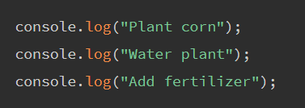
Asynchronous Operations
Operations in JavaScript are traditionally synchronous and execute from top to bottom. For instance, a farming operation that logs farming process to the console:

Slide 4
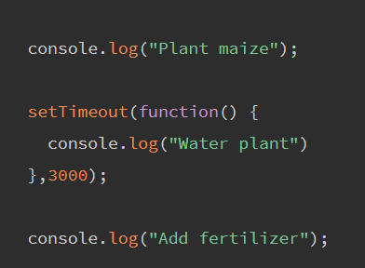
Asynchronous Operations
Operations in JavaScript are traditionally synchronous and execute from top to bottom. For instance, a farming operation that logs farming process to the console:

Slide 5

Functions are First-Class Objects
It's important to keep in mind before going through the rest of these lessons that JavaScript Functions are first-class objects in and as such can functions have the ability to:
Be assigned to variables (and treated as a value)
Have other functions in them
Return other functions to be called later

Slide 6
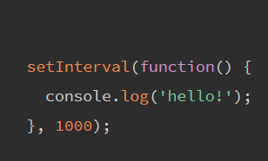
Callback Functions
When a function simply accepts another function as an argument, this contained function is known as a callback function. Using callback functions is a core functional programming concept, and you can find them in most JavaScript code; either in simple functions like setInterval, event listening or when making API calls.

Slide 7
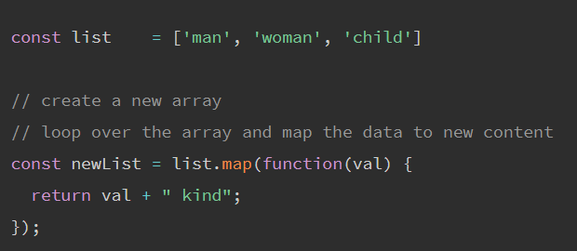
Callback Functions

Slide 8
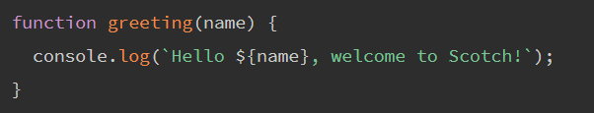
Naming Callback functions
Callback functions can be named or anonymous functions. In our first examples, we used anonymous callback functions. Let’s look at a named callback function:

Slide 9
Naming Callback functions
function introduction(firstName, lastName, callback)
{
const fullName = `${firstName} ${lastName}`;
callback(fullName);
}
introduction('Chris','Nwamba', greeting);

Slide 10
Promises
I promise to do this whenever that is true. If it isn't true, then I won't.
This is a simple illustration of JavaScript Promises. Sounds like an IF statement? We’ll soon see a huge difference.
A promise is used to handle the asynchronous result of an operation. JavaScript is designed to not wait for an asynchronous block of code to completely execute before other synchronous parts of the code can run. For instance, when making API requests to servers, we have no idea if these servers are offline or online, or how long it takes to process the server request.
With Promises, we can defer execution of a code block until an async request is completed. This way, other operations can keep running without interruption.
Promises have three states:
Pending: This is the initial state of the Promise before an operation begins
Fulfilled: This means the specified operation was completed
Rejected: The operation did not complete; an error value is usually thrown

Slide 11
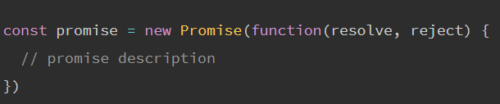
Creating a Promise

Slide 12
Creating a Promise
const weather = true
const date = new Promise(function(resolve, reject) {
if (weather)
{
const dateDetails = {
name: 'Cubana Restaurant’,
location: '55th Street’,
table: 5 };
resolve(dateDetails)
} else {
reject(new Error('Bad weather, so no Date')) } }
);

Slide 13
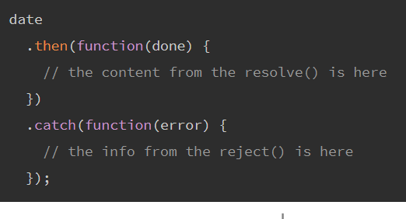
Using Promises
Using a promise that has been created is relatively straightforward; we chain .then() and .catch() to our Promise like so:

Slide 14
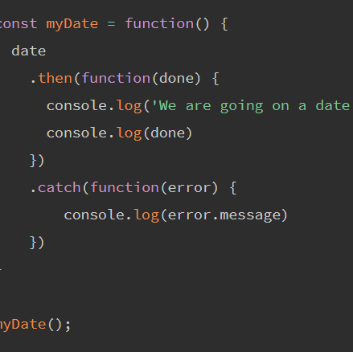
Using Promises
Using a promise that has been created is relatively straightforward; we chain .then() and .catch() to our Promise like so:

Slide 15
Await
Await is only used with an async function. The await keyword is used in an async function to ensure that all promises returned in the async function are synchronized, i:e. they wait for each other. Await eliminates the use of callbacks in .then() and .catch(). In using async and await, async is prepended when returning a promise, await is prepended when calling a promise. try and catch are also used to get the rejection value of an async function. Let's see this with our date example:

Slide 16
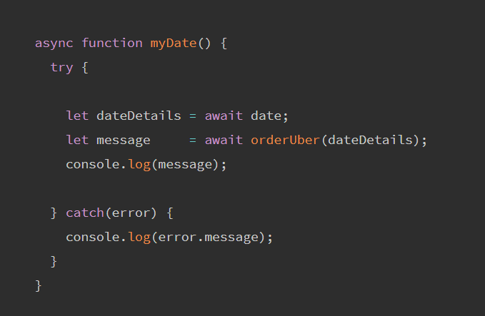
Await

Slide 17
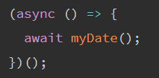
Await

Slide 18
Conclusion
Understanding the concepts of Callbacks, Promises, and Async/Await can be rather confusing, but so far we have seen how they work when carrying out asynchronous operations in JavaScript.

